Slide 1

Analysis of Dallas Street Service Requests
INFO 5709 Final Project

Slide 2

Introduction
Residents are also able to contact a non-emergency link, 311 system, to leave questions or requests for the city’s services. Most often, this system serves to address local issues, including road damages, disruptions, and vandalism, thus enabling a continuous connection channel between the public and the municipal. Moreover, the system’s data is beneficial to comprehend the people’s needs, compare the government’s actions, and define strategies for the urban expansion with its incidence levels and geography in mind.

Slide 3

Dataset Overview
Service requests are records of non-emergencies filed by the city’s residents of Dallas, Texas to the city’s 311 services. This involves problems often correlated with downtown, like road dangers, public confusion, and sabotage. By presenting a glimpse of the degree to which its services operate and the types of civic affairs departments are resolving all areas.
Time period: January 2020- February 2021;
Volume: 10907 records and 19 variables. Each entry represents one service requests.

Slide 4

EDA
The main agenda is to clean the dataset and visualizing the attributes.
Bar Graphs: Display the count of service requests by department and the top 10 service request types, highlighting which types of services are most in demand.
Pie Charts: Illustrate the distribution of service requests by status, giving a clear picture of how many requests are closed, transferred, or remain open.
Line Graphs: Show monthly service request trends over the years, revealing seasonal patterns and year-over-year changes in service demand.
Histograms: Provide insights into the distribution of estimated response times, which helps in assessing the timeliness of service delivery.

Slide 5
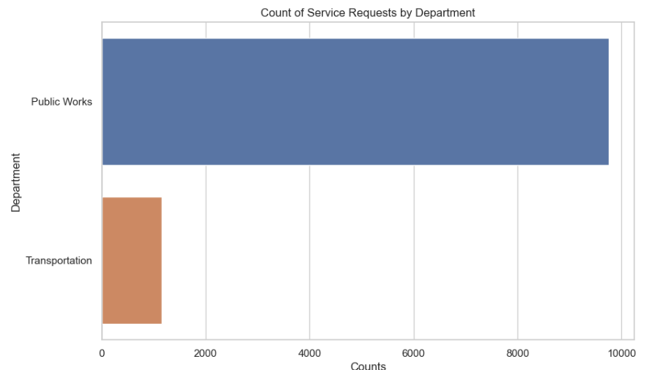
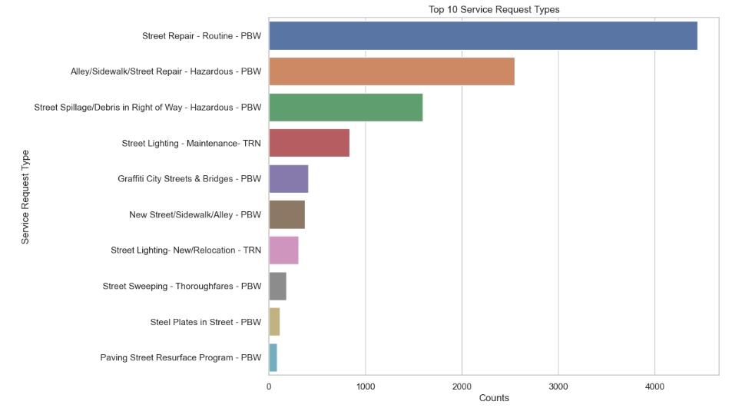
Plots

Slide 6
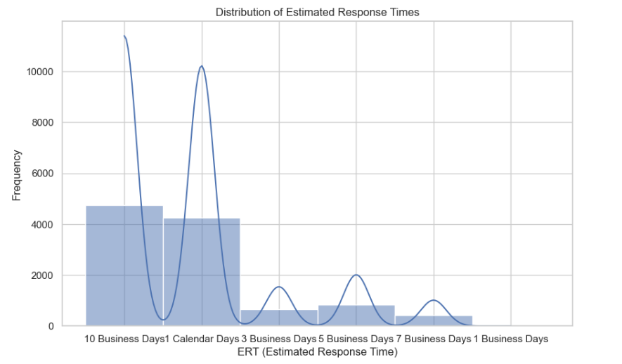
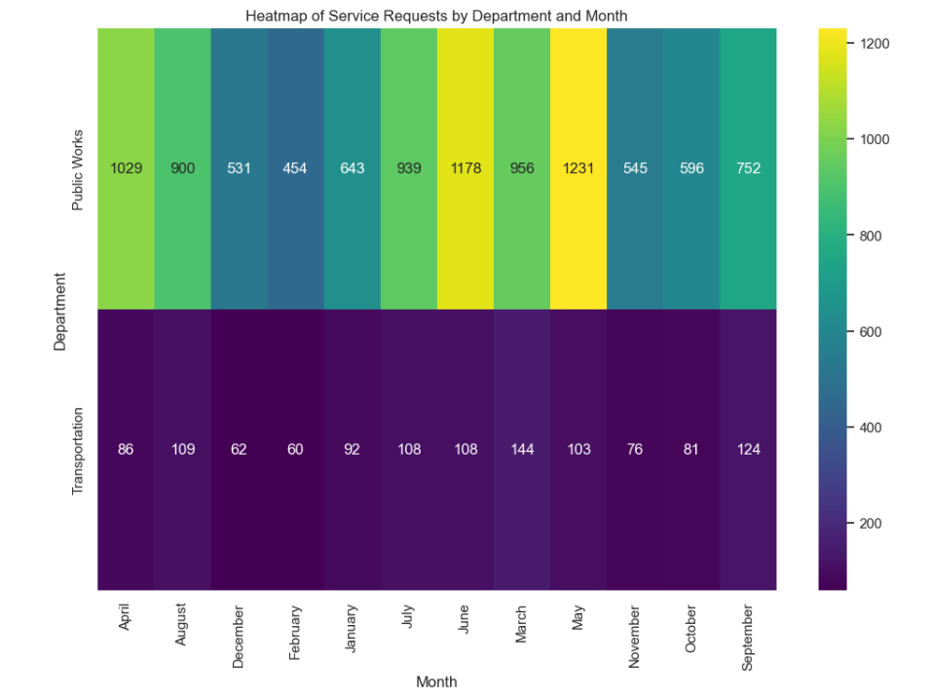
Plots

Slide 7
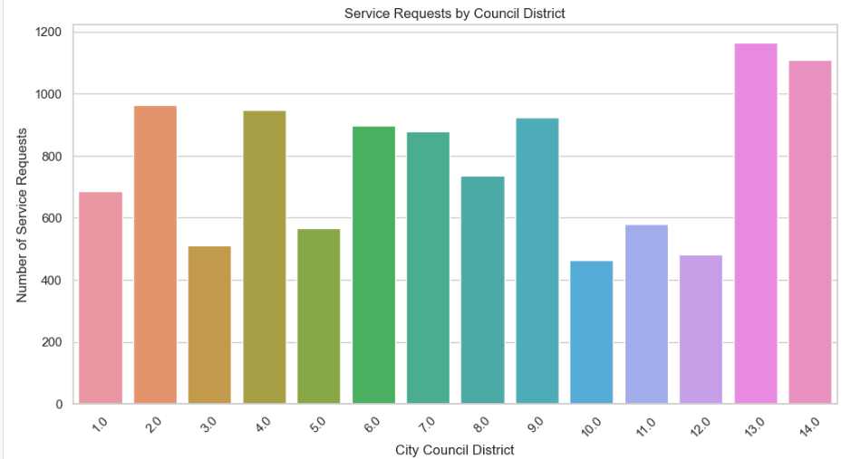
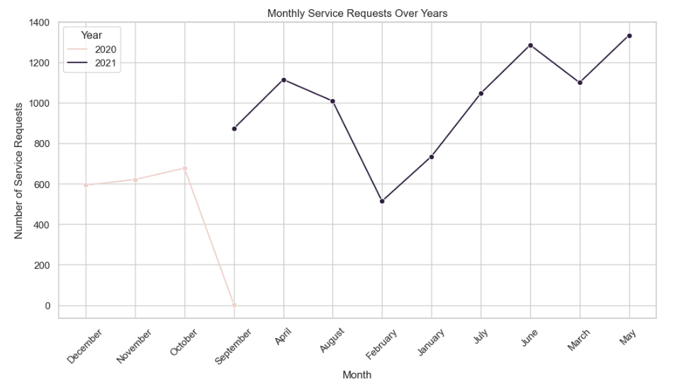
Plots

Slide 8
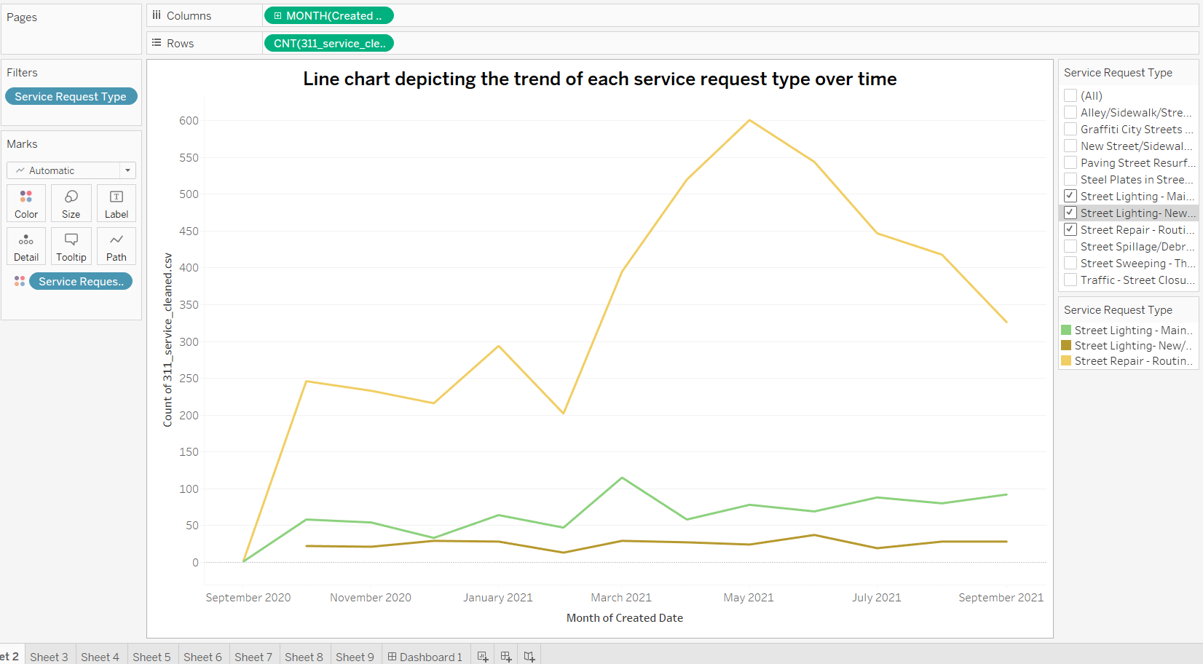
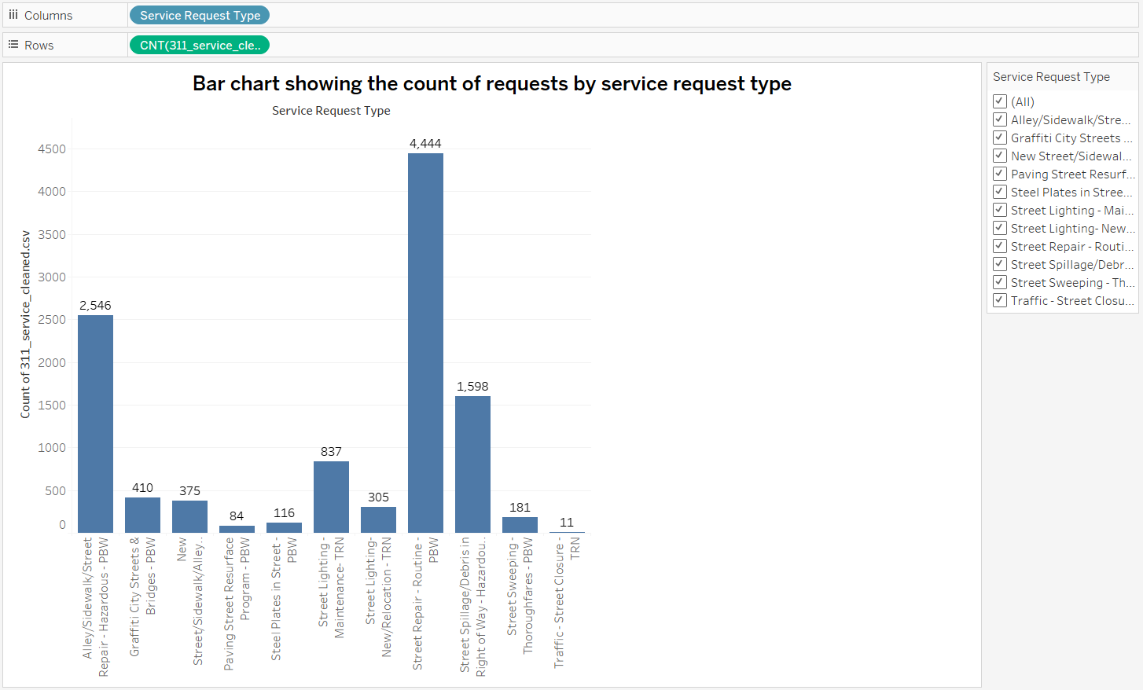
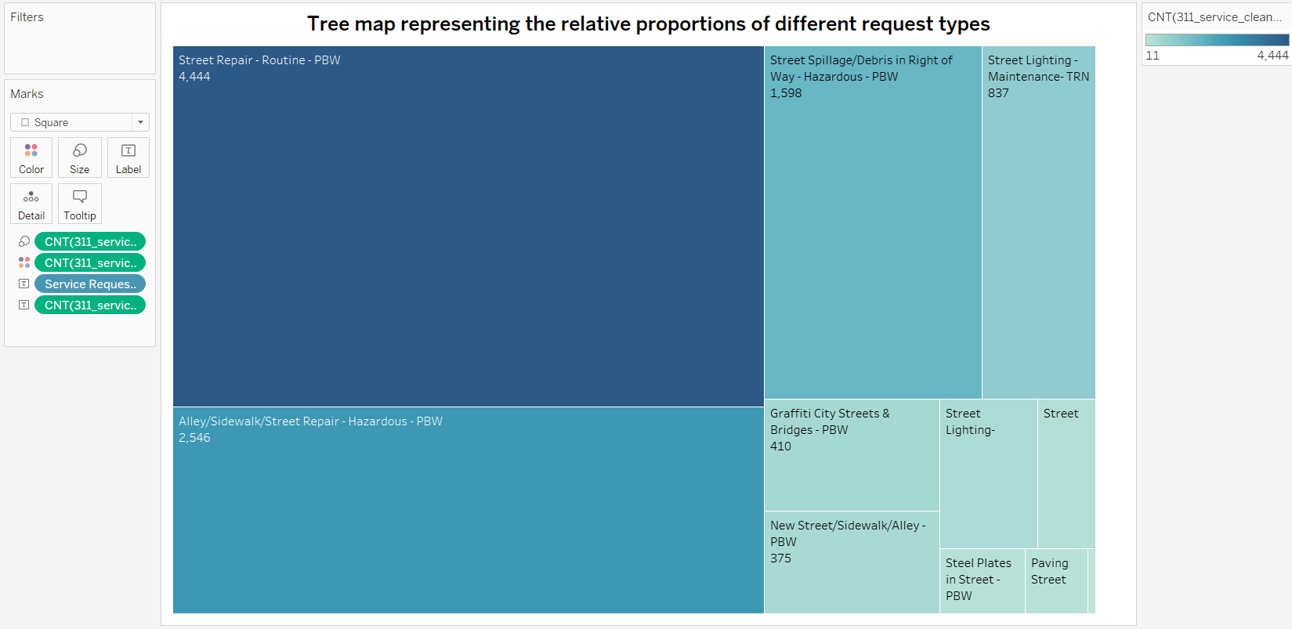
Hypothesis 1: Analyze the distribution and trends of service request types.

Slide 9
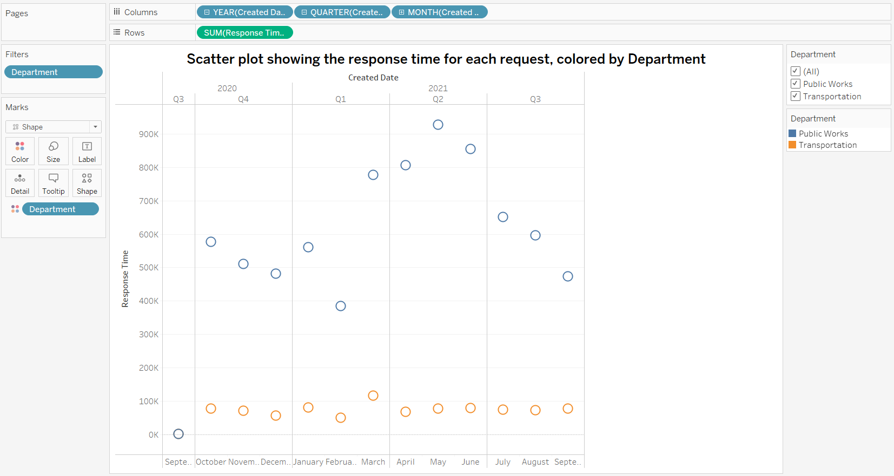
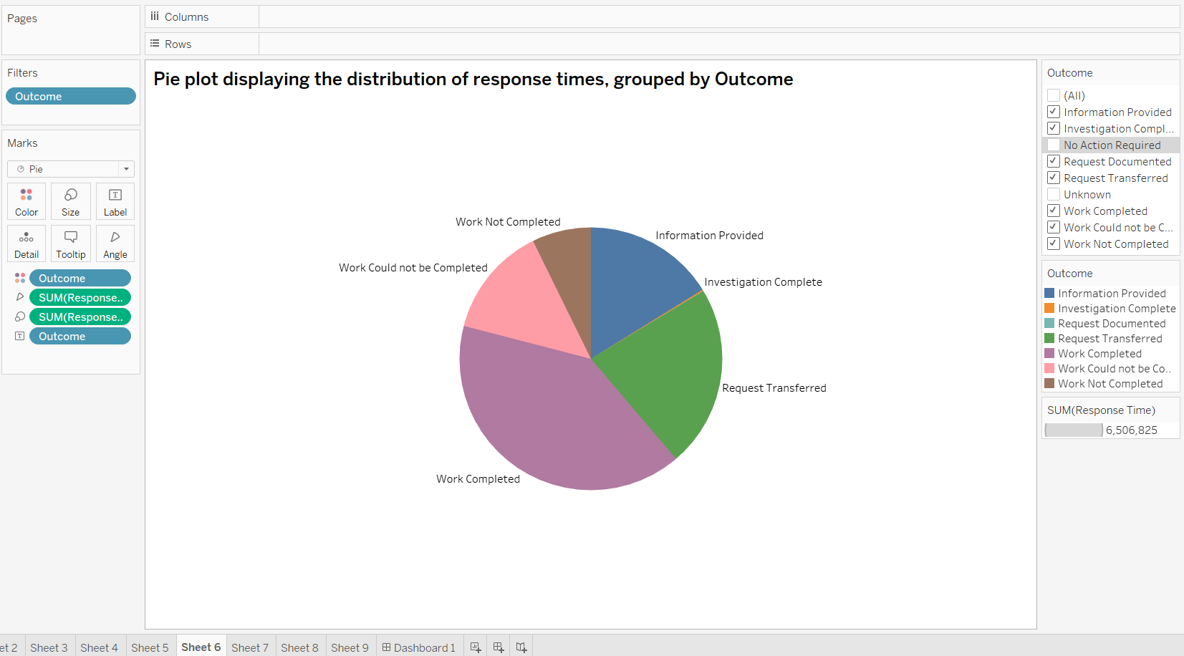
Hypothesis 2: Investigate the response times and service levels for different request types or locations.

Slide 10
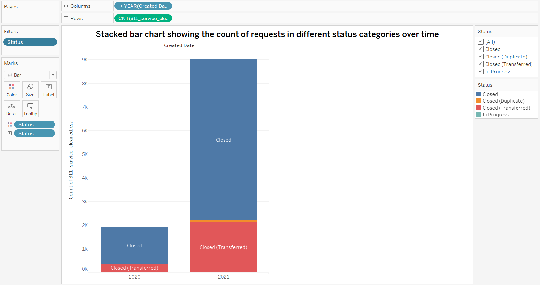
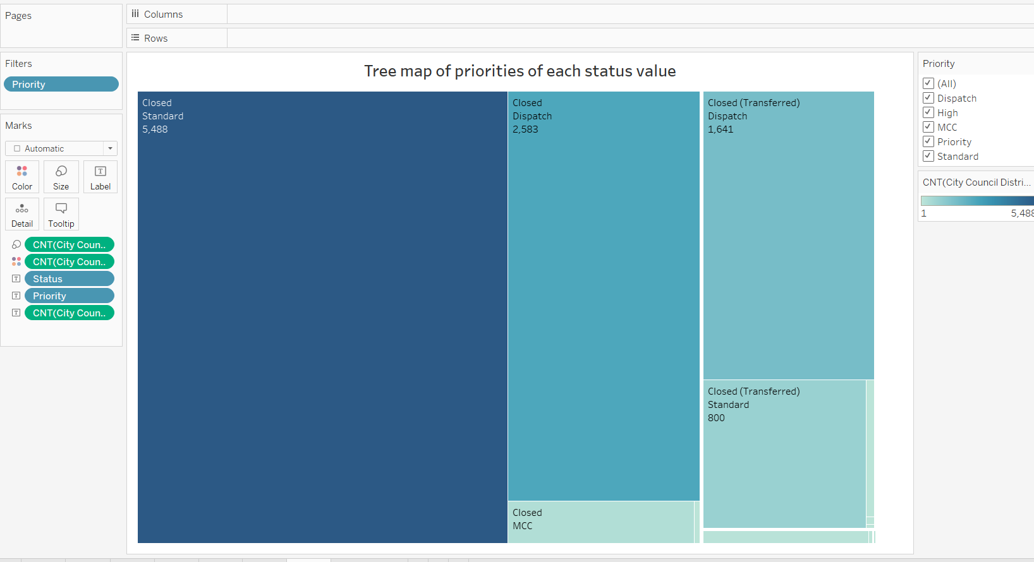
Hypothesis 3:Analyze the status and completion rates of service requests.

Slide 11

Conclusion
Indeed, such critical metrics as response times, resolution times, and the nature of complaints are present in the dataset that allow understanding to what extent well-compromised areas of streets are caught up and how fast and good the city is at their everyday job at removing a single nuisance. In turn, such indicators help one evaluate whether the city fulfills the pledged provision of service and what areas failed to demonstrate good performance.

Slide 12
Thank you

